Slide 1

WEATHER
DATA
ANALYSIS
Sudha Jennifer M. Sowmya Jyothika

Slide 2




INTRODUCTION
Welcome to the presentation on
Analyzing Weather Data using
,
, , and . We will explore how data visualization tools can provide valuable insights into weather
patterns and trends.

Slide 3

IMPORTANCE OF WEATHER DATA ANALYSIS
Understanding weather patterns is crucial for various industries such as agriculture, transportation, and disaster management. allows us to identify patterns and make informed decisions based on historical and real-time data.

Slide 4

UTILIZING NUMPY FOR DATA ANALYSIS
With its powerful mathematical functions and array operations,
enables efficient manipulation and analysis of weather data. We can perform complex calculations and statistical analysis with ease.

Slide 5


EXPLORING DATA WITH PANDAS
provides a versatile data structure for handling time series and tabular data. We can efficently clean, manipulate, and analyze weather datasets, gaining deeper
insights into trends and anomalies.

Slide 6
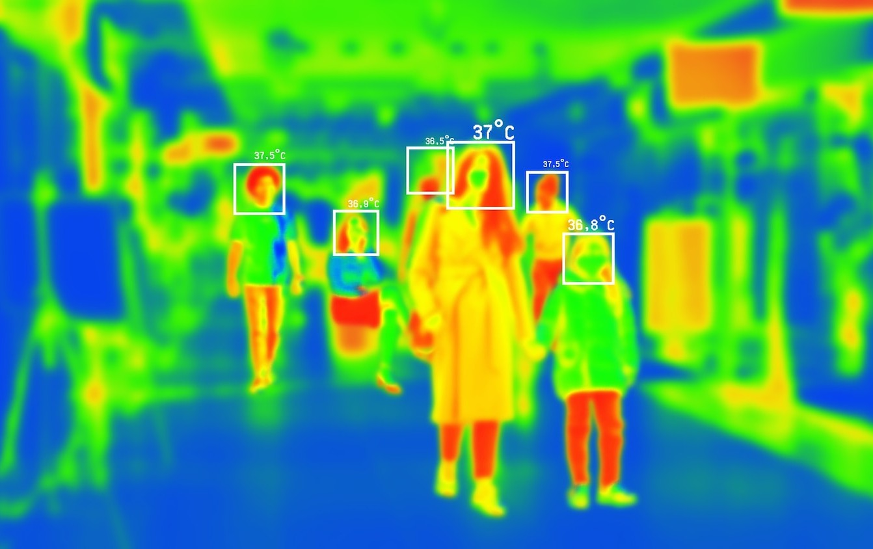

VISUALIZING WEATHER DATA WITH MATPLOTLIB
offers a wide range of visualization options, including line plots,
scatter plots, and histograms. We can create clear and informative visualizations to communicate weather patterns effectively.

Slide 7

INSIGHTS FROM GRAPHS AND CHARTS
Graphs and charts provide a visual representation of weather data, making it easier to identify trends, correlations, and anomalies. Through e ective data visualization, we can uncover valuable insights for decision-making.

Slide 8


CASE STUDY: ANALYZING HISTORICAL WEATHER DATA
We will delve into a real-world case study to demonstrate the application of
, , and in analyzing historical weather data. This
practical example will showcase the power of data visualization tools.

Slide 9

CHALLENGES AND OPPORTUNITIES
While weather data analysis presents challenges such as data quality and variability, it also offers opportunities for predictive modeling and risk assessment. Leveraging advanced tools and techniques can lead to more accurate forecasts and proactive decision-making.

Slide 10
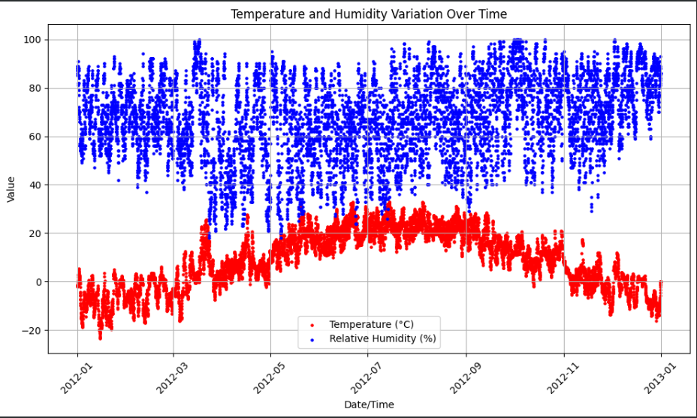
Examples from our analysis

Slide 11
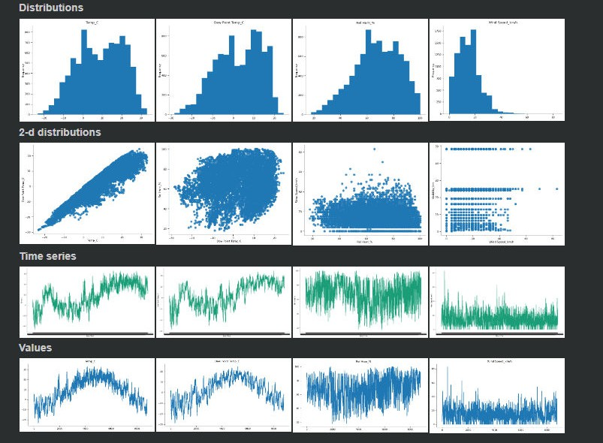

Slide 12
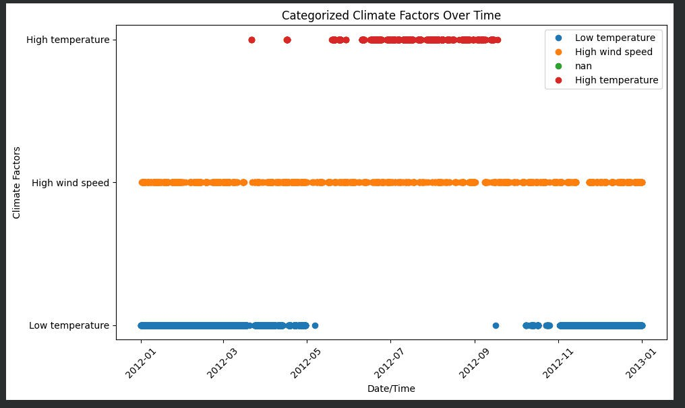

Slide 13
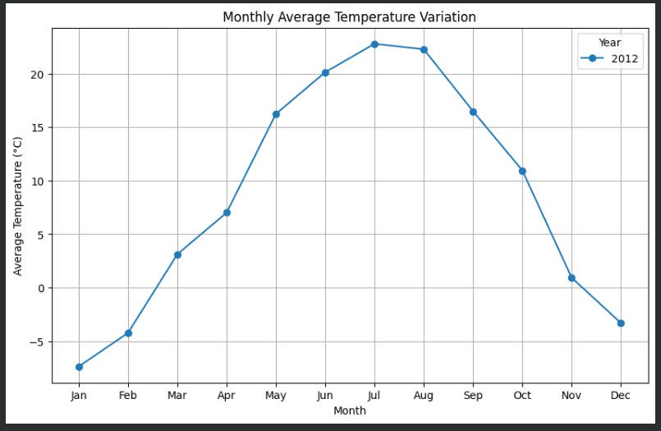
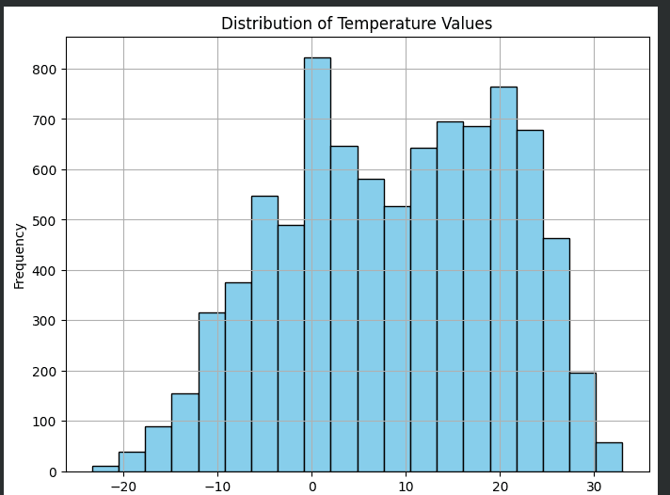

Slide 14

FUTURE TRENDS IN WEATHER DATA ANALYSIS
Advancements in machine learning and AI are revolutionizing weather forecasting and data analysis.
Integrating these technologies with traditional tools can lead to more precise predictions and actionable
insights, shaping the future of weather data analysis.

Slide 15



CONCLUSION
In conclusion, the use of , , , and empowers us to gain deeper insights into weather data. By
leveraging these tools, we can make informed decisions and drive innovation in weather analysis and forecasting.

Slide 16
Thanks!
Do you have any questions?

